Slide 1
Vista Introduction
Interacting with High Performance Computing Systems at TACC
Jack Gaither, Engineering Scientist Associate
Texas Advanced Computing Center

Slide 2
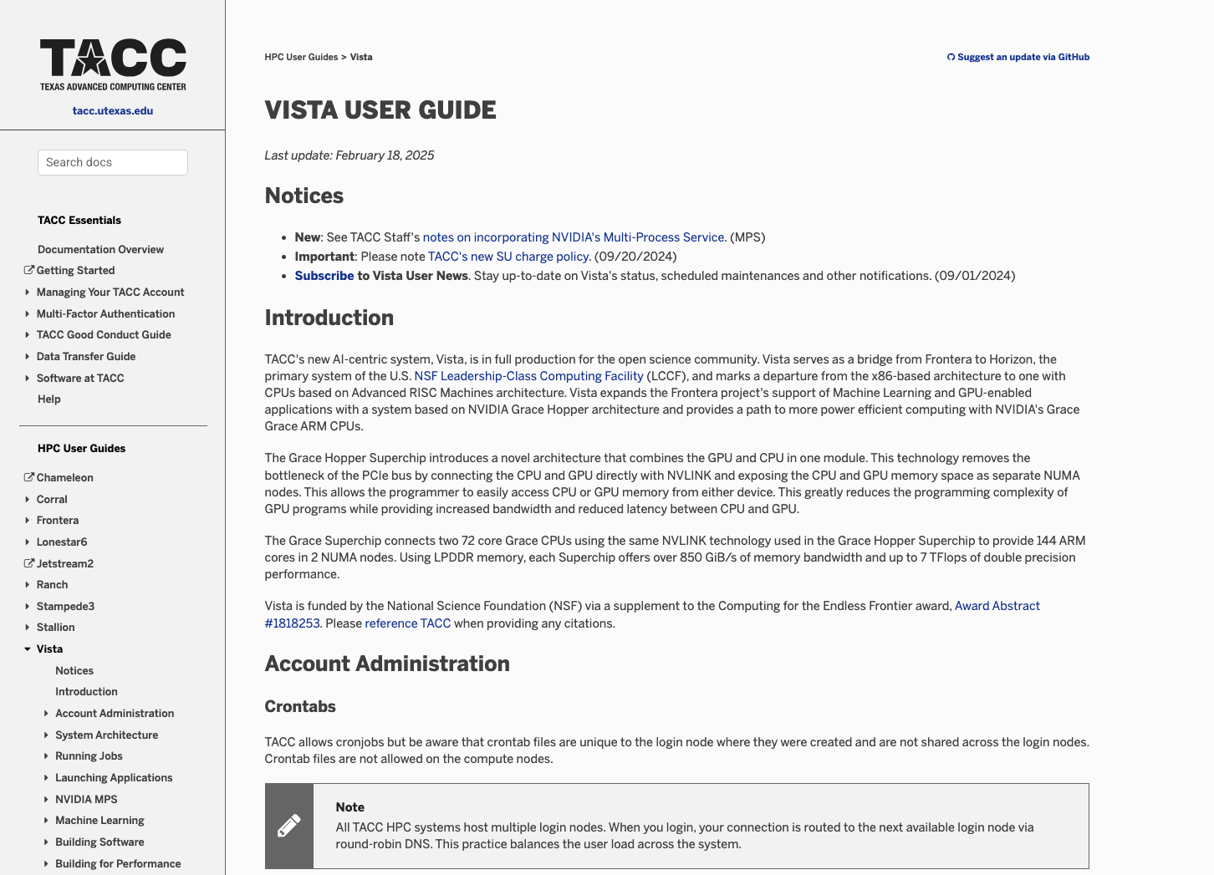
https://docs.tacc.utexas.edu/hpc/vista/

Slide 3
Logging In: What do I need?
To access Vista, you will need the following:
  Terminal application that supports SSH
  TACC Account
  Enable TACC MFA for your account on the TACC User Portal here
  Member of a project with an active Vista allocation

Slide 4
Logging In: What do I see?
Project Membership
Available SUs (and expiration date)
Disk Quotas

Slide 5
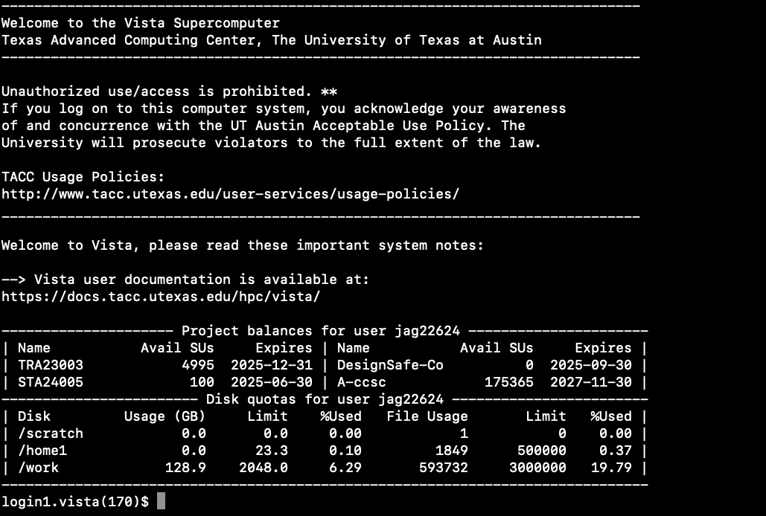

Slide 6
Vista File Management
Comprised of three file systems:
  $HOME
    Quota of 23GB or 500,000 files
    Not intended for parallel or high-intensity file operations
    Backed up regularly
    Not purged
  $WORK
    Quota of 1TB or 3,000,000 files across all TACC systems
    Not intended for high-intensity file operations or jobs involving very large files.
    Not backed up
    Not purged
  $SCRATCH
    No quota
    Intended for high-intensity file operations or jobs involving very large files
    Not backed up
    Files are subject to purge if access time is more than 10 days old info found here

Slide 7
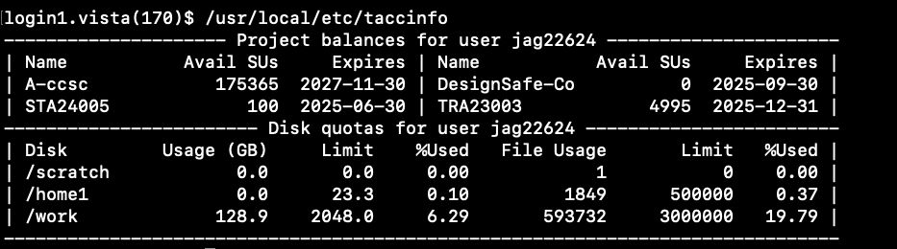
Using the File Systems
Check quota with /usr/local/etc/taccinfo

Slide 8
Navigating the File System
Basic bash commands:
  cd
    Change directory: cd $WORK
  ls
    List the contents of a directory: Ls -al
  mv
    Move a file or directory to another directory
  cp
    Copy a file or directory to a directory: cp </some/file> </destination/directory>
  pwd
    Print working directory to get the file path to your current directory

Slide 9
Transferring Files
For SSH file transfer utilities we typically use scp or rsync
  Docs for scp here
  Docs for rsync here

Slide 10
Sharing Project Files
The simplest way to have a shared workspace with collaborators that are in your group and part of your allocation is to use unix group level permissions on your files and directories
To do this we use the command: chmod 750
  This will allow full rwx access for the owner and r-x for your group, allowing them to read and execute those shared files without being able to edit
For additional info on sharing project files visit here

Slide 11
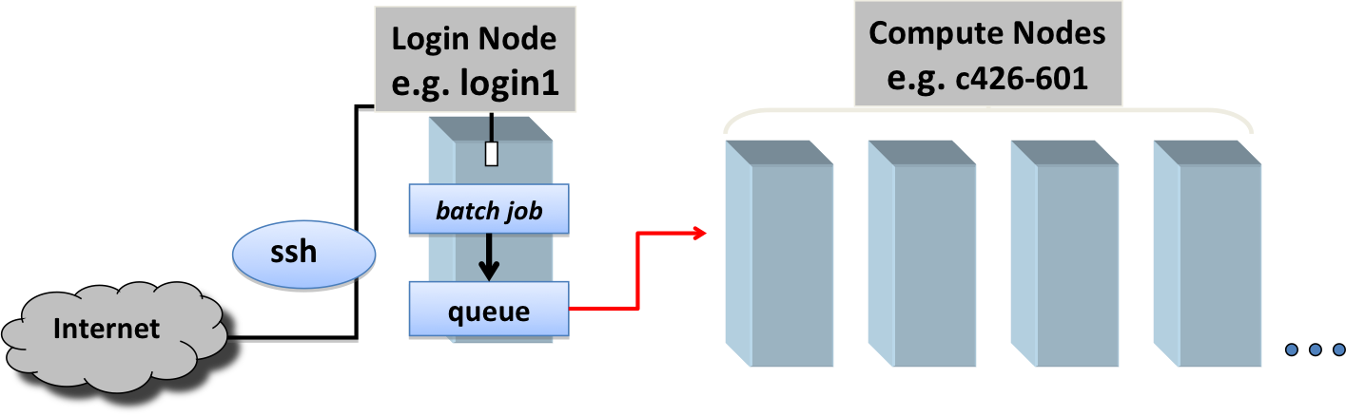
Vista Overview

Slide 12
Good Citizenship on Vista
Do NOT run jobs on the login nodes
Do NOT stress the shared file system
Limit Input/Output (I/O) activity
Adhere to file transfer guidelines

Slide 13
Vista
Production queues (gg, gh, gh-dev)
  qlimits command displays info on queues
SLURM Workload Manager (job scheduler)
  jobID
  Submit (sbatch, idev)
  Manage and monitor (squeue, scontrol, scancel)

Slide 14
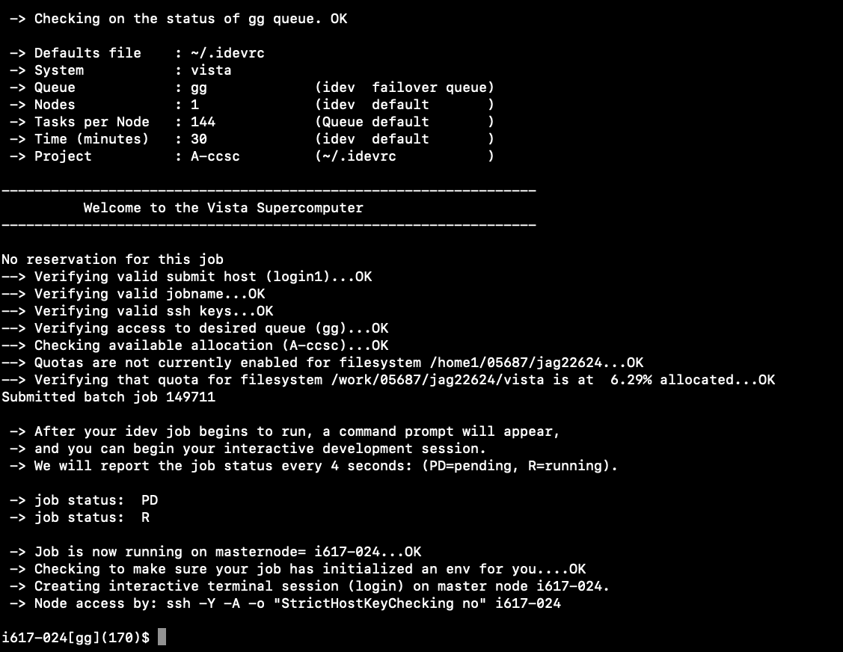
idev
Uses SLURM to start an interactive session on a compute node
30 minutes, single node, development queue
Perfect for compiling, running i/o intensive applications, testing sbatch jobs before submitting them as an sbatch job

Slide 15
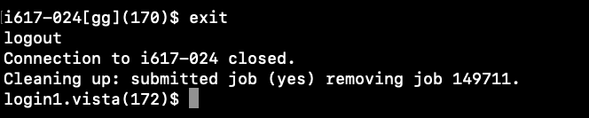
Exit an idev session

Slide 16
Submitting a job using sbatch
Uses #SBATCH directives to request computing resources
A table of common #SBATCH options can be found here
Sbatch jobs are meant for applications that do not require any interactivity from the user

Slide 17
SLURM batch file
#!/bin/bash
#SBATCH -J myjob # Job name
#SBATCH -o myjob.o%j # Name of stdout output file
#SBATCH -e myjob.e%j # Name of stderr error file
#SBATCH -p gg # Queue (partition) name
#SBATCH -N 1 # Total # of nodes
#SBATCH -n 144 # Total # of mpi tasks
#SBATCH -t 00:05:00 # Run time (hh:mm:ss)
#SBATCH --mail-type=all # Send email at begin and end of job
#SBATCH -A <your allocation> # Project/Allocation name (req'd if you have more than 1)
#SBATCH --mail-user= <your email here>
# Any other commands must follow all #SBATCH directives...
module list
pwd
date
# Launch code...
echo “Hello World” # Use ibrun instead of mpirun or mpiexec

Slide 18
Submitting the job
To submit the SLURM Batch job use the following command: sbatch batchjob.sh
This should generate a text output to let you know about the parameters of the job and then provide you with a Job ID once the job has successfully been admitted to the queues

Slide 19
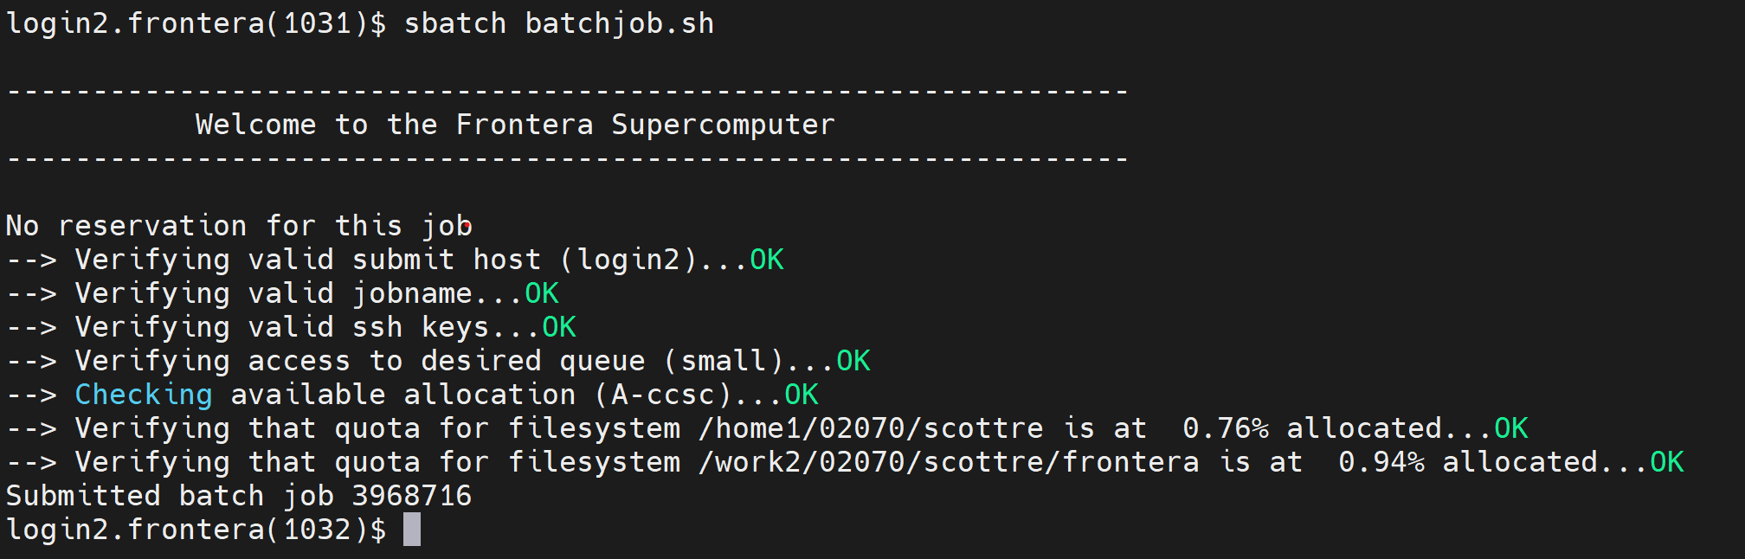
Submitting the job

Slide 20
Check Status of Job
squeue -u <your username>
squeue -j <job id or comma delimited list of job ids>
Jobs have three states:
  PD means Pending
  R means Running
  CG means Completing (cleaning up after exiting the job)

Slide 21
Cleaning up jobs
When your batch job has finished running it will automatically be cleared from the queues.
Your output will be in the folder you pointed it to within your batch job file.
If for some reason you wish to cancel your job while it is still running, you can do so with scancel <jobID>

Slide 22
Tacc Analysis Portal (TAP)
Web portal interface that allows users to run DCV, VNC, Jupyter Notebook, and Rstudio sessions interactively with an available display
Very useful for interactive development with data visualization eliminating the need to copy files to local to view generated images/figures
Documents page here

Slide 23
Monitoring Jobs IO Do’s
Do:
  Use $SCRATCH for production jobs and take advantage of /tmp space if possible info here
  Work with large files rather than many tiny files if possible
  Use a single stripe for small files and stripe large files on the Lustre file systems info on striping here
  Open/close only once for each file if possible rather than conducting open/close/state operations repetitively
  Use scalable Parallel I/O libraries, like phdf5, pnetcdf, PIO
  Install Python/R modules under $SCRATCH
  Copy Python/R modules under /tmp for large-scale runs Use Python_Cacher
  Use profilers or I/O monitoring tools when necessary

Slide 24
File Striping
Lustre can stripe (distribute) large files over several physical disks, making it possible to deliver the high performance needed to service input/output (I/O) requests from hundreds of users across thousands of nodes
a file with 16 stripes, for example, is distributed across 16 OSTs
A good rule of thumb is to allow at least one stripe per 100GB in the file.
  While the $WORK file system has hundreds of OSTs $SCRATCH has far fewer meaning we need to limit the stripe count to no more than 8
$WORK striping ex: lfs setstripe -c 12 $PWD
$SCRATCH striping ex: lfs setstripe -c 8 $PWD
To get the stripe count for a file or directory use the command: lfs getstripe myfile

Slide 25
Job Tools
REMORA or REsource MOnitoring for Remote Applications link here
  Remora provides a simple interface to gather important system utilization data while running on HPC systems. Remora monitors almost all user activities and provides per-node and per-job resource usage data for users
CD Tools or Collect-Distribute link here
  has been designed and developed to distribute files or directories to or from the /tmp directory
OOOPS or Optimal Overloaded I/O Protection System link here
  easy-to-use tool to help HPC users optimize heavy I/O requests and reduce the impact of high I/O jobs
Python_Cacher link here
  For jobs that make use of large numbers of Python modules or use local installations of Python/Anaconda/MiniConda

Slide 26
Comments, Questions, Cool Stuff?
Thank you for attending!

